Slide 1
CSS- Display

Slide 2
CSS Display
The display CSS property is used to configure the display style of any element, inline, block, inline-block, flex, grid etc.
Syntax:
Selector {
display: value;
}

Slide 3
Value | Description
inline | It will display the content beside existing.
block | It will display content in new line.
grid | It can display content in rows and columns.
flex | It uses flexible display. It is cross browser compatible attribute used for creating layouts like float and position.
none | It hides the elements from DOM hierarchy.
table | It can have the display like table element.
Initial | Sets the property to its default value.
Inherit | Inherits from its parent element.

Slide 4
display:inline
When an element is styled with display:inline, it will not start on a new line, will only take up as much width as the content it contains, and will not cause a line break after it.
List of "inline" elements:-
<a> <abbr> <acronym> <b> <bdo> <big> <br> <button> <cite> <code> <em> <i> <img> <input> <label> <map> <object> <output> <q> <script> <select> <small> <span> <strong> <sub> <sup> <textarea> <time> <tt> <var>
display:block
Any element styled with display: block is the polar opposite of display:inline. A block element starts on a new line and occupies the available width of its parent element or its specified width.
List of “block" elements:-
<address> <article> <aside> <blockquote> <canvas> <dd> <div> <dl> <dt> <fieldset> <figcaption> <figure> <footer> <form> <h1> -<h6> <header> <hr> <li> <main> <nav> <noscript> <ol> <p> <pre> <section> <table> <tfoot> <ul> <video>

Slide 5
display:inline-block
The difference between an inline element and an inline-block element is that an inline-block element can take up specified width and height. But, it will also not start on a new line within its parent or cause a line break after it.

Slide 6
<html>
<head>
<title>Display inline</title>
<style>
.inline{
display:inline;
width: 100px;
height:100px;
border: 1px solid black;
}
.inline-block{
display:inline-block;
width: 100px;
height:100px;
border: 1px solid black;
margin-top: 5px;
}
.block{
display:block;
width: 100px;
height:100px;
border: 1px solid black;
margin-top: 5px;
}
</style>
</head>
<body>
<div class="inline">Hello</div>
<div class="inline-block">Hello</div>
<div class="block">Hello</div>
</body>
</html>

Slide 7
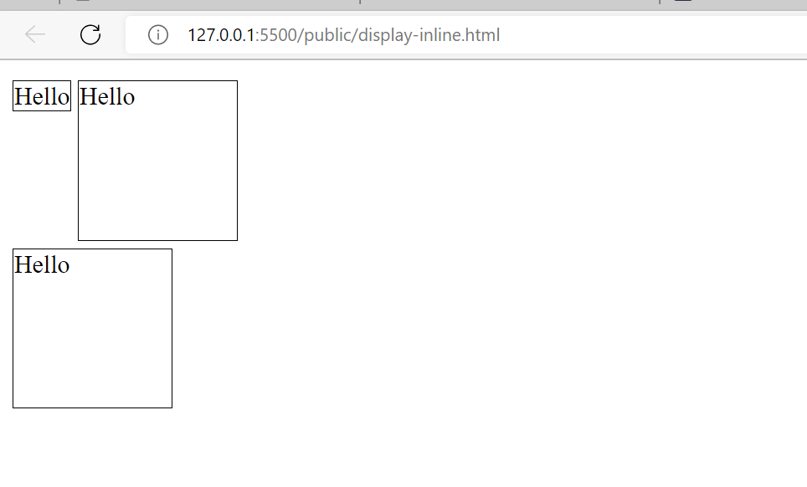

Slide 8
Display: none
display: none; is commonly used with JavaScript to hide and show elements without deleting and recreating them.
<!DOCTYPE html>
<html>
<head>
<style>
h1.hidden {display: none;}
</style>
</head>
<body>
<h1>This is a visible heading</h1>
<h1 class="hidden">This is a hidden heading</h1>
<p>Notice that the h1 element with display: none; does not take up any space.</p>
</body>
</html>
Output:-
1. With display:none;
This is a visible heading
Notice that the h1 element with display: none; does not take up any space.
2. Without display:none;
This is a visible heading
This is a hidden heading
Notice that the h1 element with display: none; does not take up any space.

Slide 9
Using visibility: hidden <!DOCTYPE html> <html> <head> <style> h1.hidden { visibility: hidden; } </style> </head> <body> <h1>This is a visible heading</h1> <h1 class="hidden">This is a hidden heading</h1> <p>Notice that the hidden heading still takes up space.</p> </body> </html>
Output:-
This is a visible heading
Notice that the hidden heading still takes up space.

